Slide 1




Small Business Expo
Health and Wellbeing
2nd May 2024
Notes:
how to look after yourself and your staff in order to build a healthy workplace culture. The session will outline new psychosocial workplace regulations, as well as easy to use tools and resources available to support you and your small business to become safer, healthier and more sustainable for the future.

Slide 2
Acknowledgment of Country
We acknowledge this land that we meet on today is the traditional lands for the Kaurna people and that we respect their spiritual relationship with their country.
We also acknowledge the Kaurna people as the custodians of the Adelaide region and that their cultural and heritage beliefs are still as important to the living Kaurna people today.
We also pay respects to the cultural authority of Aboriginal people attending from other areas of South Australia and Australia.

Slide 3
Kylie Cocks
Acting Program Manager Healthy Workplaces
Notes:
Hi – I have a few questions for you?
What was the last thing you did to improve your wellbeing?
When did you do this (today, yesterday, last week?)
Where were you? (at work, at home, in the community somewhere)
Who – were you with ( yourself, your family or friends or pet)
Why – what was your reason to do this activity? (keep fit, keep mental health in check, health professional told you)
Last question is - Did you feel guilty for doing this activity or when doing it that you felt you should have been doing something else?

Slide 4
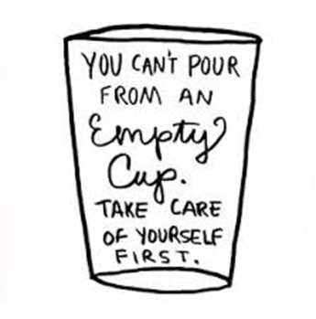
Look after you
Stay connected to friends and family
Maintain a healthy lifestyle (physical exercise, eating well, good sleep)
Establish boundaries to work hours
Take time out to notice
Seek advice and access supports when needed
Tune in to early signs of stress and take action on the main causes.
Notes:
The pressures of running a business, finding worklife balance, and adapting constantly to business pressures means so often that self-care is often the first thing that gets sacrificed when life is busy and stressful, and people often think that taking time for themselves seems indulgent.
Finding effective ways to look after your health and wellbeing in your business is important for keeping things running smoothly.
Looking after yourself – putting on your own oxygen mask
Practising self-care involves building it into your daily/weekly care for yourself - also recognising when your personal resources are running low and replenishing yourself rather than letting them run down to a point where it impacts on your health and wellbeing.
Role modelling this is also critical to a successful wellbeing program or healthy workplace.
This is the lighting bolt reminder for you to:
Stay connected to friends and family
Maintain a healthy lifestyle (physical exercise, eating well, good sleep)
Keep working hours in check
Take time out to relax and unwind
STune in to early signs of stress
eek advice and access supports when needed

Slide 5
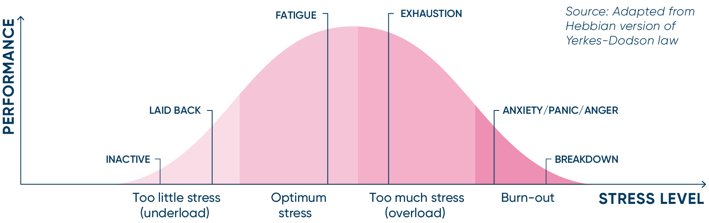
Finding optimum
Notes:
Lets talk stress
The Yerkes-Dodson Law (Yerkes & Dodson, 1908) is a well-known finding in the psychology literature. In summary, the law suggests that performance increases with mental arousal (stress) but only up to a point. When an individuals’ level of stress is too low or too high, their performance deteriorates.
The ‘optimum’ level of stress is not the same for everyone! Each individual will have their own relationship between stress and task performance – this is known as the Yerkes-Dodson law.8
It proposes that you reach your peak level of performance with an intermediate level of stress or arousal. Too little or too much arousal results in poorer performance.
This shows us that performance increases with stress to a point, beyond which additional stress becomes counterproductive. Spend too long past the optimum point in the stress curve and we risk exhaustion, anxiety and eventually a breakdown and burnout.
Take a look at the picture below. According to what is known as “The Yerkes-Dodson law,” performance increases with physiological or mental arousal (stress) but only up to a point. When the level of stress becomes too high, performance decreases.
Mental health is not fixed, but instead it varies dynamically under the influence of a range of factors.

Slide 6
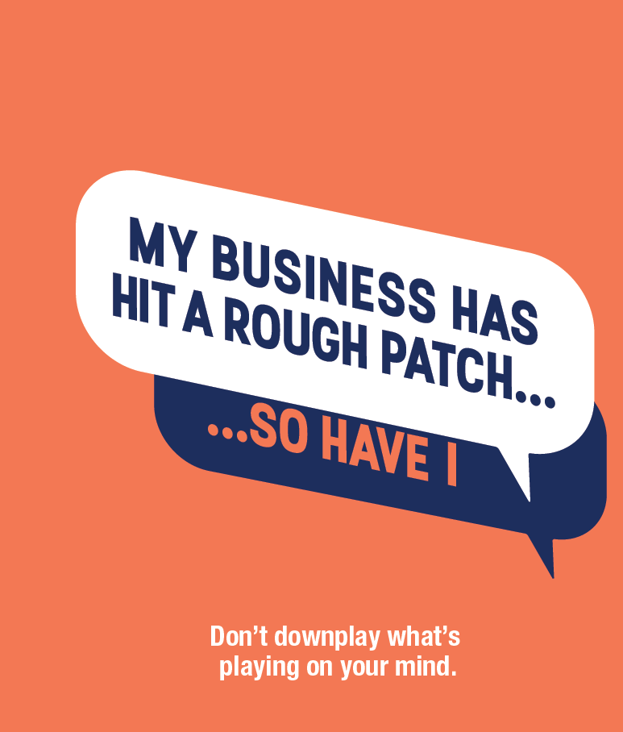
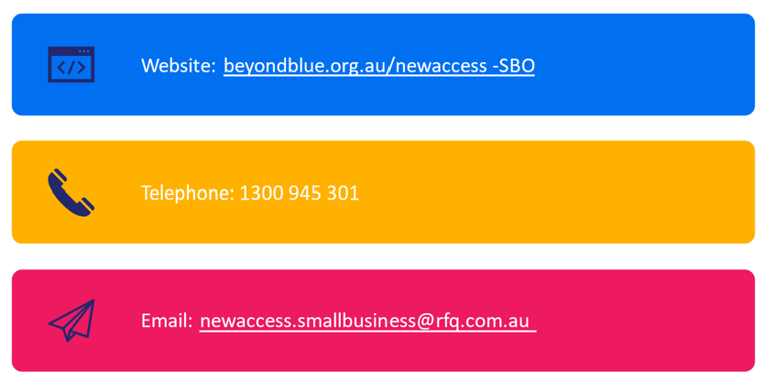
NewAccess for Small Business Owners -

Slide 7

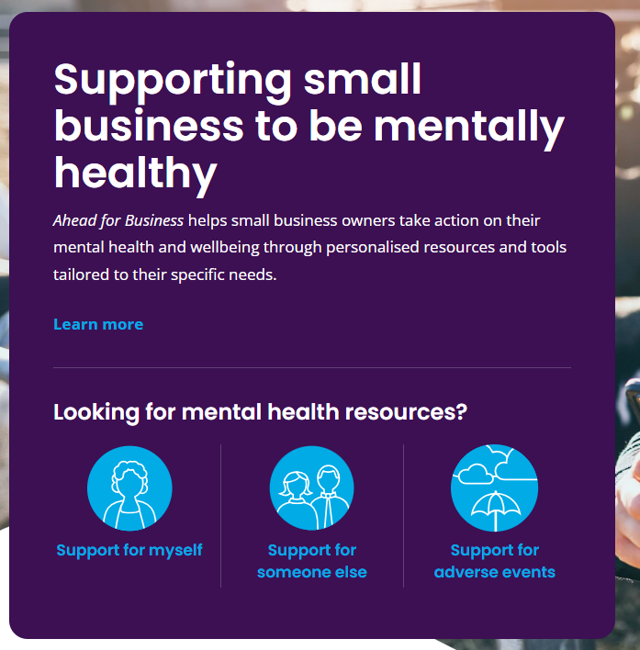
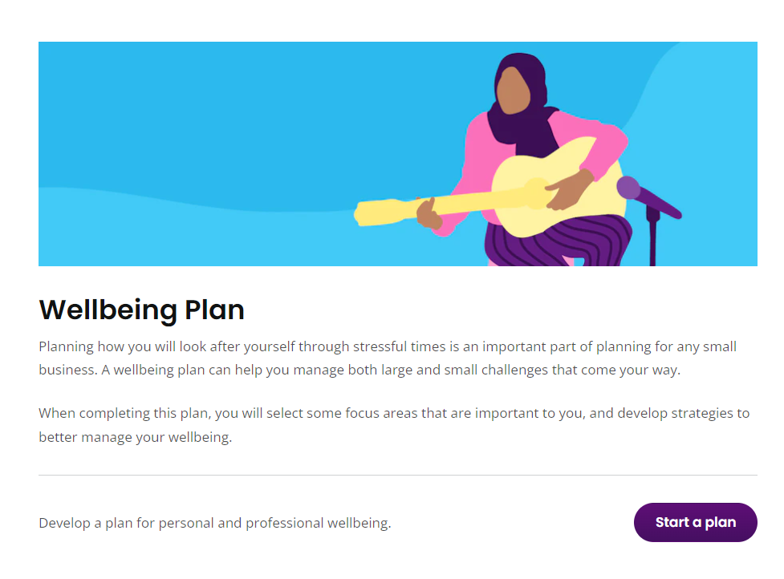
www.aheadforbusiness.org.au
Notes:
The Ahead for Business digital portal supports mentally healthy small businesses.
Funded by The Australian Treasury, the Ahead for Business digital portal has been developed with and for small businesses.
The portal provides tailored resources, check-ups, personalised action plans and showcases the experiences of small business owners through podcasts, videos, blogs and case studies.

Slide 8
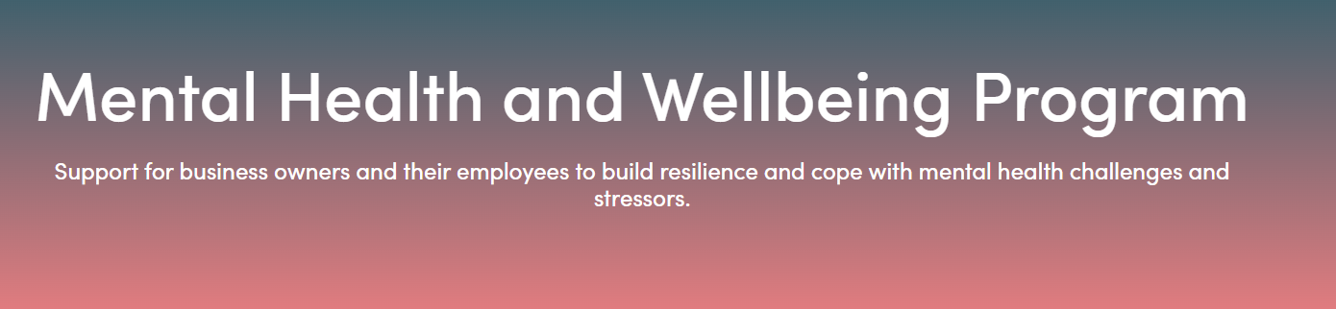

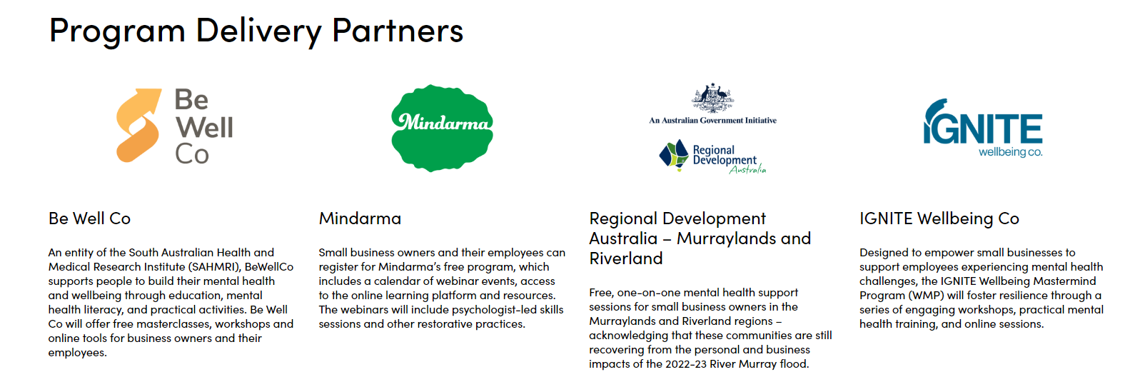
Notes:
South Australian small business owners can access mental health and wellbeing support for themselves and their employees at low or no cost, beginning in 2024.
Aiming to increase resilience and capability to cope with mental health challenges, this program offers a range of support activities, including masterclasses, education and training sessions, workshops, one-on-one support, psychologist-led skills sessions, webinars, e-learning, and online tools and resources.
Five organisations with demonstrated experience delivering evidence-based mental health support have been selected as program partners and will design and deliver highly targeted offerings for small business owners.

Slide 9
Health and wellbeing in business?
the right thing to do – people deserve to work in a place where their health and wellbeing matter
the smart thing to do – it can save money and there is a cost of doing nothing
the legal thing to do – workplaces must comply with relevant legislation and regulatory requirements
the safe thing to do – it reduces workplace injuries and keep workers safe and healthy

Slide 10
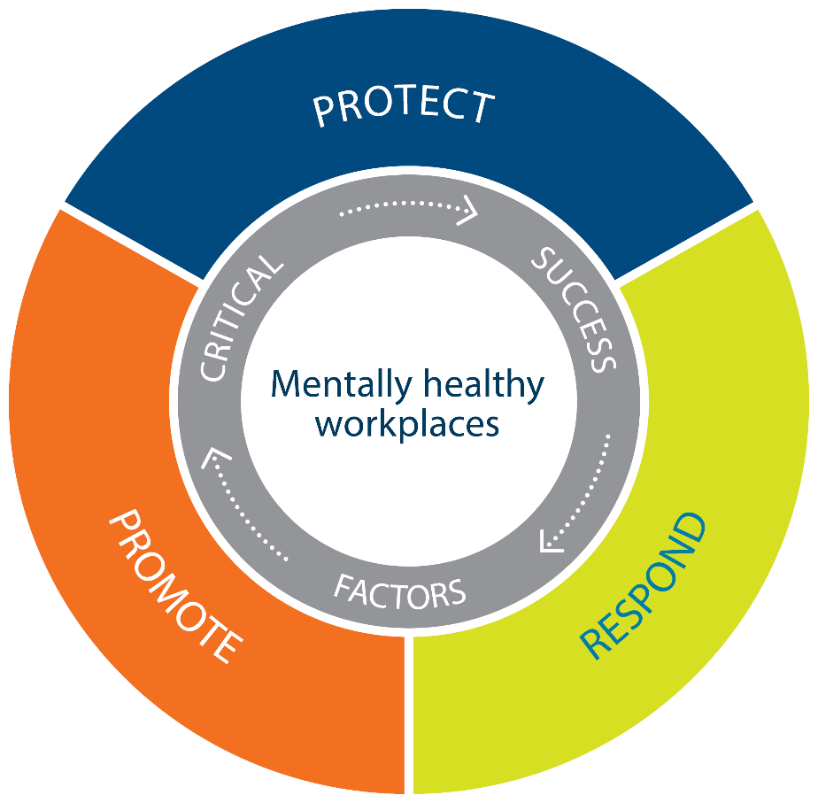



Identify and manage work-related risks to mental health
Support people experiencing mental ill-health or distress
Recognise and enhance the positive aspects of work that contribute to good mental health
Adapted from National Mental Health Commission’s “Blueprint for Mentally Healthy Workplaces”
Notes:
Current best practice principles, take an integrated approach to better mental health which focuses on three key pillars of promote, protect and respond.
This model provides practical way for you to think about mental health actions and to organise activities around workplace mental health.
Protect – preventing harm by identifying and managing work-related risks to mental health
Respond - building capabilities in the workplace to identify and support people who are stressed, struggling or experiencing mental ill-health.
Promote – recognising and enhancing the positive aspects of work that contribute to good mental health.

Slide 11

Jason Mavrikis
Chief Advisor Psychosocial
Notes:
Hi – I have a few questions for you?
What was the last thing you did to improve your wellbeing?
When did you do this (today, yesterday, last week?)
Where were you? (at work, at home, in the community somewhere)
Who – were you with ( yourself, your family or friends or pet)
Why – what was your reason to do this activity? (keep fit, keep mental health in check, health professional told you)
Last question is - Did you feel guilty for doing this activity or when doing it that you felt you should have been doing something else?

Slide 12
Psychosocial hazards arising from or relating to:
Psychological harm
Depression
Anxiety
Burnout
Post traumatic stress disorder
Design or management of work
Stress response
Work environment
Workplace interactions and behaviours
When frequent, prolonged or severe
Physical harm
Cardiovascular disorders
Musculoskeletal disorders
Plant at a workplace
Figure 1. Model of work-related stress

Slide 13

Hazard
Job demands
Low job control
Poor support
Lack of role clarity
Poor organisational change management
Inadequate reward and recognition
Poor organisational justice
Traumatic events and material
Remote or isolated work
Poor physical environment
Violence and aggression
Bullying
Harassment including sexual harassment
Conflict or poor workplace relationships and interactions
Potential harm
Depressions, anxiety, MSDs and cardiovascular ill-health
Absenteeism
Presenteeism

Slide 14
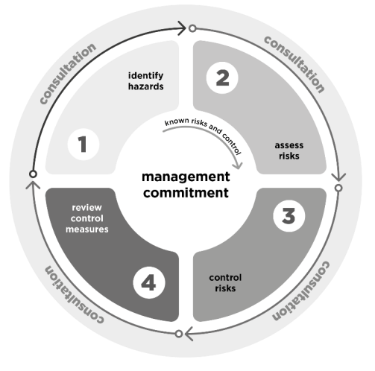
Four steps to prevention - overview of the process to manage psychosocial risks
Manage workplace risks to psychological health as you would for physical health and safety
Step 1: Identify the hazards
Step 2: Assess the risks
Step 3: Control the risks
Step 4: Review
Do this in consultation with workers
Image from Model Code of Practice Managing Psychosocial Hazards at Work 2022

Slide 15
Psychological health – tools and resources
Psychological health for small business (SafeWork SA)
  Provides practical suggestions on the ‘do(s)’ and ‘don’t(s)’ on ‘how’ to control the risks associated with each organisation’s psychological hazard.
How to examine and interrogate workplace data – (SafeWork SA)
  Data can help to identify and assess potential psychosocial hazards. Sources of data can vary depending on the size of your organisation. The data source table below will help you identify some that may be available to your organisation.
Psychosocial risk assessment tool – (SafeWork SA)
  This risk assessment tool is designed to help employers meet their legal obligations to manage risks associated with psychological injury
Focus group guide
  Focus groups can help you identify and analyse emerging psychosocial hazards and inform future planning identified in the risk assessment process. They’re ideal for consulting with workers and enable the collection of meaningful data on people’s perceptions of their work environment.
  People at Work psychosocial risk assessment tool (state/territory WHS regulators)
  A validated survey-based measurement tool that aims to help organisations identify and manage psychosocial risk.

Slide 16
What should organisations do now?...
Treat psychosocial risks, including sexual harassment, like any other WHS risk
Review your existing WHS systems
Consult, consult and consult some more!
Maintain up-to-date knowledge

Slide 17
What should organisations do now?...
Ask questions about culture
Be proactive
Officers must engage
Review your HR framework
Think outside of the box
Do not ‘set and forget’

Slide 18
Mardi Webber
Mentally Healthy Workplaces Consultant
Notes:
Hi – I have a few questions for you?
What was the last thing you did to improve your wellbeing?
When did you do this (today, yesterday, last week?)
Where were you? (at work, at home, in the community somewhere)
Who – were you with ( yourself, your family or friends or pet)
Why – what was your reason to do this activity? (keep fit, keep mental health in check, health professional told you)
Last question is - Did you feel guilty for doing this activity or when doing it that you felt you should have been doing something else?

Slide 19
Creating an environment that reduces stigma, makes it safe to talk, supports early intervention, and ensures people in the business are able to recognise, respond, and refer to appropriate support services.
Notes:
Mardi
Okay so the next pillar we are going to take you through is Respond – this covers a few things including:
Reducing stigma
Creating environments where it is safe to talk
Early intervention
Education – recognise the signs
And ensuring staff have access to support services
The idea here is that organisations can build capability to respond and support people experiencing mental ill-health or distress, whether it be work or non-work related.

Slide 20

Reduce mental health related stigma
Management play a key role
What is it?
Negative stereotypes, prejudice and discrimination towards people experiencing mental health issues
What to do?
Learn more about mental health and how best to respond
Create an inclusive and respectful culture
Educate staff about mental health
Speak openly about mental health in the workplace
Have regular conversations with staff and check on their wellbeing.
Notes:
What is it?
Negative stereotypes, prejudice and discrimination towards people experiencing mental health issues, including those living with a diagnosed mental health condition, such as anxiety or depression.
Stigma in the workplace can:
lead to discriminatory behaviour, including bullying and harassment
affect people’s attitudes and beliefs towards those struggling with experiences of mental ill-health (including themselves)
prevent those with experiences of mental ill-health from feeling safe to disclose and seek support from their manager/supervisor and others around them.
Information sharing and education are key to the reduction of mental health related stigma in the workplace.
The actions of managers can help reduce stigma in the workplace - managers can:
Learn more about mental health and how best to respond in the workplace.
Establish a positive working environment by minimising workplace risks to mental health, such as job stress.
Develop workplace mental health and wellbeing policies, where they are required.
Communicate the commitment to equal opportunity and privacy–this will help develop a safe and inclusive culture in the workplace.
Educate teams around mental health, such as through online resources and training.
Speak openly about mental health in the workplace, which can make others feel more comfortable to do the same.
Have regular conversations with staff and check on their wellbeing.

Slide 21
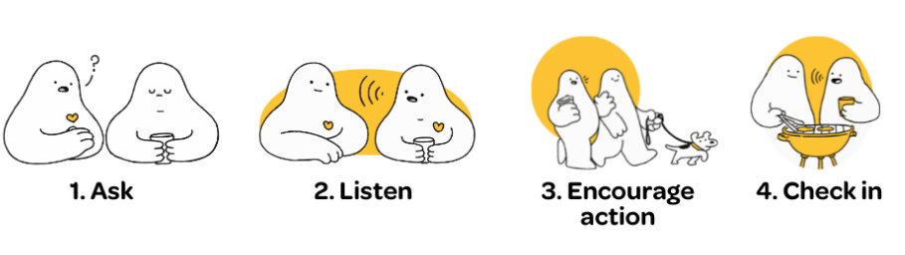

Have supportive conversations
Knowledge and skills to have supportive conversations e.g. mental health first aid
Recognise the signs that someone is stressed or struggling e.g. changes in behaviour, work performance or attendance
Reach out early and have supportive conversations
4 simple steps to ask RUOK? www.ruok.org.au
Notes:
Signs someone may be struggline:
turning up late to work, often off sick or taking unexplained days off
finding it hard to make decisions, manage tasks or meet deadlines
loss of confidence
changes in attitudes to work e.g. negativity, less engaged
struggling to concentrate
change in behaviour e.g. becoming withdrawn; mood changes
change in physical appearance e.g. looking tired, less interest in appearance or personal hygiene
Find a private space to have the conversation
Check in and ask them how they are going. Tell them what you have observed
and how this is different to usual behaviour
Listen without judgement
Encourage the person to take action – let them know about supports available
Follow up – make time to check in
Look after yourself and seek support if you have been affected by the conversation
RUOK has a fantastic conversation guide. It’s okay to say ‘you don’t seem yourself’ or ‘I’ve noticed you haven’t been as chatty lately’ – it shows you care.

Slide 22
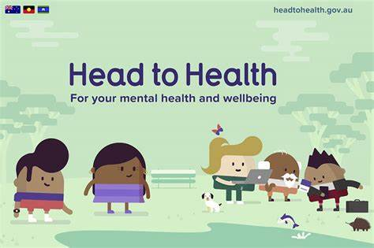

Promote support services
Digital resources
    National 24/7 services include:
    Beyond Blue: Call 1300 224 636 www.beyondblue.org.au
    Lifeline Call: 13 11 14 www.lifeline.org.au
    13YARN: Call 13 92 76 www.13yarn.org.au
    1800 RESPECT: Call 1800 737 732 www.1800respect.org.au
    State based services include:
    Lived Experience Telephone Support Service (Metro Adelaide )
      Call: 1800 013 755 www.letss.org.au
  Regional Access Call (Regional SA)
      Call: 1300 032 186 www.saregionalaccess.org.au
www.headtohealth.gov.au
www.wellmob.org.au

Slide 23
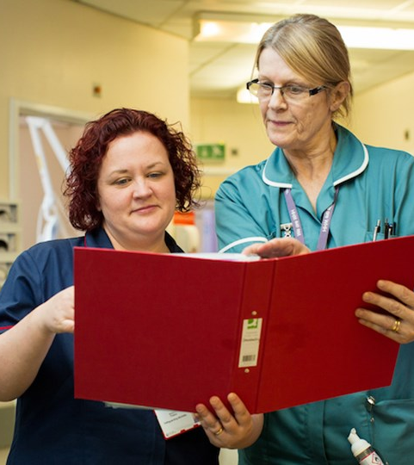
Supportive return to work practices
When a worker is injured, providing a supportive environment ensures workers return to work safer and sooner, which is good for the individual and the business.
Small business can support return to work by:
  Understanding your responsibilities
  Reporting injuries & making claims early
  Providing suitable duties
  Ensuring supportive leadership
  Being involved in the process
Notes:
When a worker is injured, providing a supportive environment ensures workers return to work safer and sooner, which is good for the individual and the business.
There are many health benefits of being in good work, and that applies even if a worker can’t perform all of their normal duties.
Small business can support return to work by:
Understanding your responsibilities as an employer, as well as what the RTW scheme has to offer.
Reporting injuries & making claims early to ensure workers receive timely and adequate support to recover
Providing suitable duties that they can do whilst they recover
Ensuring supportive leadership across the business, but particularly between worker and their direct manager
And….Being involved in all aspects of the workers recovery and return to work, this includes maintaining contact and connection with the worker and proactively engaging with the claims agent throughout the process.

Slide 24
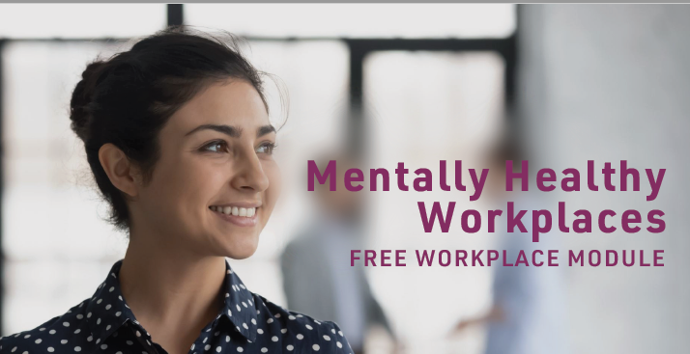
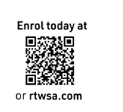
Toolkit of resources
Under the pillar of Respond
RUOK www.ruok.org.au
Mental Health First Aid Australia www.mhfa.com.au
A Head for Business www.aheadforbusiness.org.au
ReturnToWorkSA www.rtwsa.com
  Employer Education Team
  Hotline: (08) 8238 5958
  Mentally Healthy Workplaces Service
  Hotline: (08) 8233 2310

Slide 25
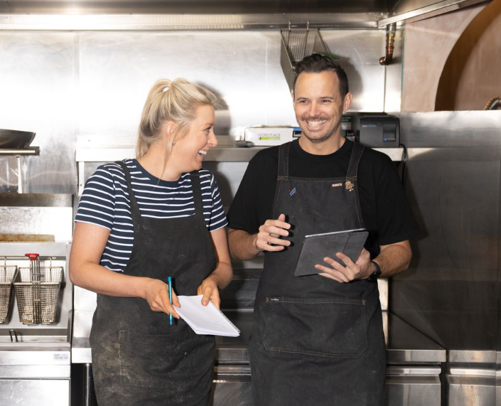
Positive aspects of work
stimulating work
meaning and purpose in work
strong workplace connections
opportunities for personal and professional growth
positive and supported leadership
personal resources to adopting healthy behaviours
Notes:
Recognise and enhance the positive aspects of work that contribute to good mental health, ones that foster a healthy, positive, and supportive workplace culture.
Promote positive mental health
Workers who feel positive about the environment and
culture in their workplace are more likely to perform
better, contribute to employee engagement, and
be more committed to the workplace. They are also
less likely to experience work-related stress, sustain a
psychological injury or leave the workplace.
Promoting positive mental health involves taking
a strengths-based approach and focusing on the
opportunities, strengths, and resources that will help
to foster a healthy, positive, and supportive workplace
culture. People thrive when they have:
• strong workplace connections
• meaning and purpose in work
• opportunities for personal and professional growth
• positive and supported leadership
• increased personal resources.
Mental health and wellbeing can also be improved
when workers are offered opportunities to address
smoking, alcohol, healthy eating, and physical activity
risk factors. Adopting these healthy behaviours can
improve wellbeing and resilience. Good mental health
and a positive frame of mind means employees are
better equipped to resist stress, tackle challenges and
develop resilience.
By building on the aspects of work that help people
optimise wellbeing, workplaces can function at their
best too.
Designing work that incorporates and considers how to optimise the job characteristics in the SMART Work Design model will lead to more meaningful and motivating work, which has significant benefits for employees and employers alike.

Slide 26
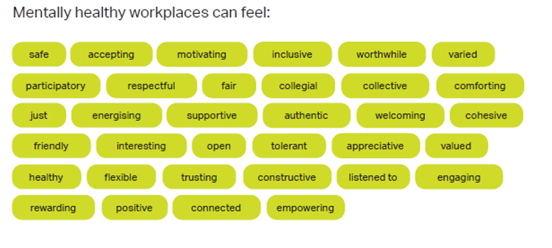
Source: Blueprint for Mentally Healthy Workplaces. National Workplace Initiative

Slide 27

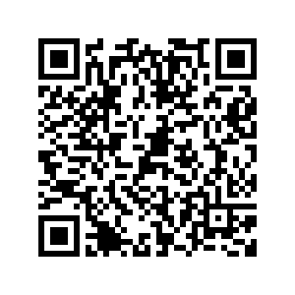
Toolkit of resources
Notes:
Optional if there’s enough time.

Slide 28
Our contact details
Mardi Webber
Mentally Healthy Workplaces Consultant, ReturnToWorkSA
Hotline: 08 8233 2310 Email: mentallyhealthy@rtwsa.com
Kylie Cocks
A/Program Manager, Healthy Workplaces, Preventive Health SA
Phone: (08) 7117 9163 Email: healthyworkplaces@sa.gov.au
Jason Mavrikis
Chief Advisor Psychosocial, Regulatory Assurance, Compliance and Enforcement Directorate, SafeWork SA
Phone: (08) 8522 0789 Email: jason.mavrikis@sa.gov.au

